Slide 1
C:
type sizes in memory
pointers

Slide 2
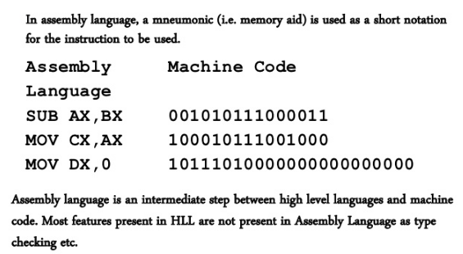
Assembly Language

Slide 3
How does C language manage memory?
There's a joke that C has
the speed and efficiency of assembly language…
  unfortunately
  combined with readability of assembly language…
You can directly access memory in C!
// Casting 32 bit int, 0x0000ffff, to a pointer
char * ptr = reinterpret_cast<char *>( 0x0000ffff ) ;
char * ptr2 = reinterpret_cast<char *>( 0x0000ffff ) ;
Memory address
Arbitrary pointer casting allows you to point anywhere in memory.
NOT SAFE!!

Slide 4
Remember your computer organization class…
Yes, you CAN see C type sizes!!
#include <stdbool.h>
#include <stdio.h>
#include <stdlib.h>
#include <limits.h>
#include <float.h>
int main ( void ){
int i;
bool b;
char c;
double r;
printf("The size of int is:%ld\n",sizeof(i));
printf("The size of bool is:%ld\n",sizeof(b));
printf("The size of char is:%ld\n",sizeof(c));
printf("The size of double is:%ld\n",sizeof(r));
/* for more info, https://en.wikipedia.org/wiki/Data_structure_alignment*/
return 0;
}
ssh to eng1.mu.edu.tr (using putty)
Follow instructions at http://eng1.mu.edu.tr/~tugba/PL/Slides/Week2.bitbucket.pdf to fork week2 to your local at eng1
fork pllab2018/week2 to your local at eng1
edit c.c (using nano c.c)
compile c.c (cc c.c)
run your program to test ( ./a.out)
You ran your first C++ program on Linux!!

Slide 5
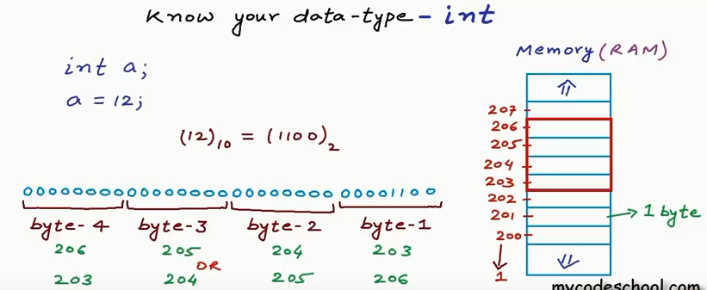

Slide 6
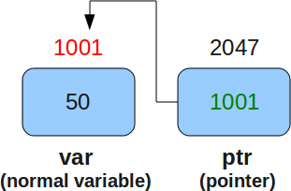

Slide 7
Pointer arithmetic in C
Consider the integer array
    int arr[ 10 ] ;
What type does arr have?
  arr is an “int array”
How much space does arr occupy in memory?
    40 bytes (int size was? 4 bytes. Remember. We allocated 10 integers in memory)
    What type does arr[2] have?
    int
What will this code print?
    i=1000000;
    int j=1000000;
  printf("i*j:%d\n",i*j);

Slide 8
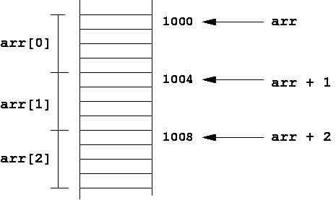
arr[ 2 ] is same as
* ( arr + 2 ) !!!!
If arr is at address 1000
then arr + 1 is address 1004
arr + 2 is address 1008!

Slide 9
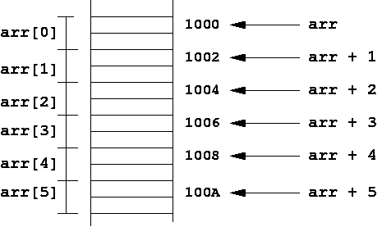
What if you have short arr[10]? short has size 2 bytes!

Slide 10
Static arrays are constant!!
When you declare
int arr[ 10 ] ;
arr is now a constant
Memory address of Constant arr is defined to be the address:
& arr[ 0 ]
You can't do the following:
  int arr[ 10 ] ;
  arr = arr + 1 ; // NO! Can't reassign to arr--it's constant
  However, you can declare a pointer variable
  int arr[ 10 ] ;
  int * ptr ;
  ptr = arr + 1 ; // This is OK. ptr is a variable.

Slide 11
Let’s print memory addresses
bool b;
char c;
int i;
double r;
int arr[10];
printf("The address of the bool is:%ld\n",&b);
printf("The address of the char is:%ld\n",&c);
printf("The address of the int is:%ld\n",&i);
printf("The address of the arr is:%ld\n",&arr);
printf("The address of the arr[1] is:%ld\n",&arr[1]);

Slide 12
More pointer arithmetic
string line;
cout <<"Can you type the address of arr[2] and press enter >>";
cin >> line;
if ( atoll(line.c_str()) == (long long) &arr[2]){
cout <<"YES! You guessed right! \n\n";
}
else{
cout <<"Wrong answer:" <<line <<"\n";
printf(" Correct answer is:%ld\n\n",&arr[2]);
}

Slide 13
More pointer arithmetic
/*more pointer arithmetic*/
int * ptr = arr ;
*(ptr+2)+=1;
cout <<"int * ptr = arr;\n";
cout <<"*(ptr+2)+=1;\n";
cout <<"Can you guess the value of arr[2]?"<<"\n";
cin>>line;
if ( atoi(line.c_str()) == arr[2]){
cout <<"YES! You guessed right!\n arr[2] is equal to *(ptr+2) and its value is ";
cout <<*(ptr+2) <<"\n\n";
}
else {
cout <<"Nope, sorry, try again,correct answer is: ";
cout <<*(ptr+2) <<"\n\n";
}

